Slide 1
Time-Series Recommender:
Recommending export growth across time, countries, and products
Faran Sikandar
Insight AI Fellow
August 2019

Slide 2
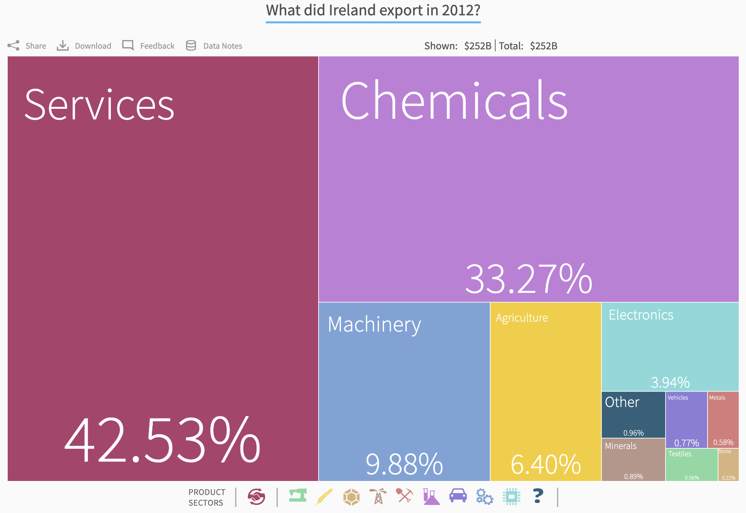
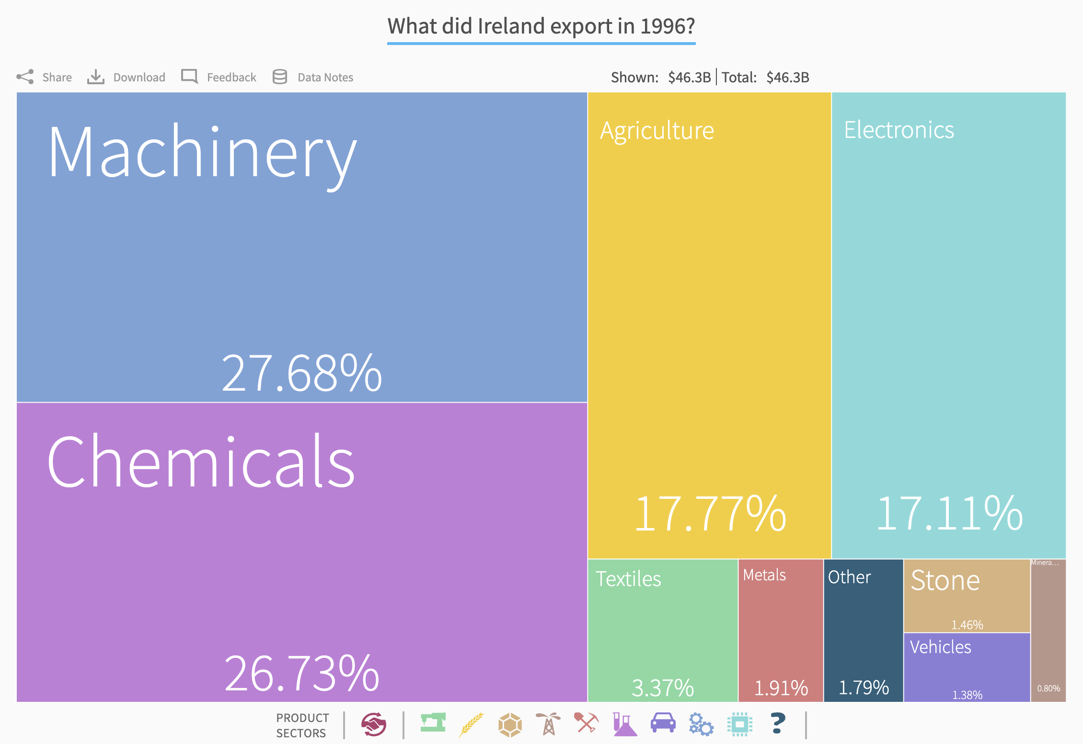
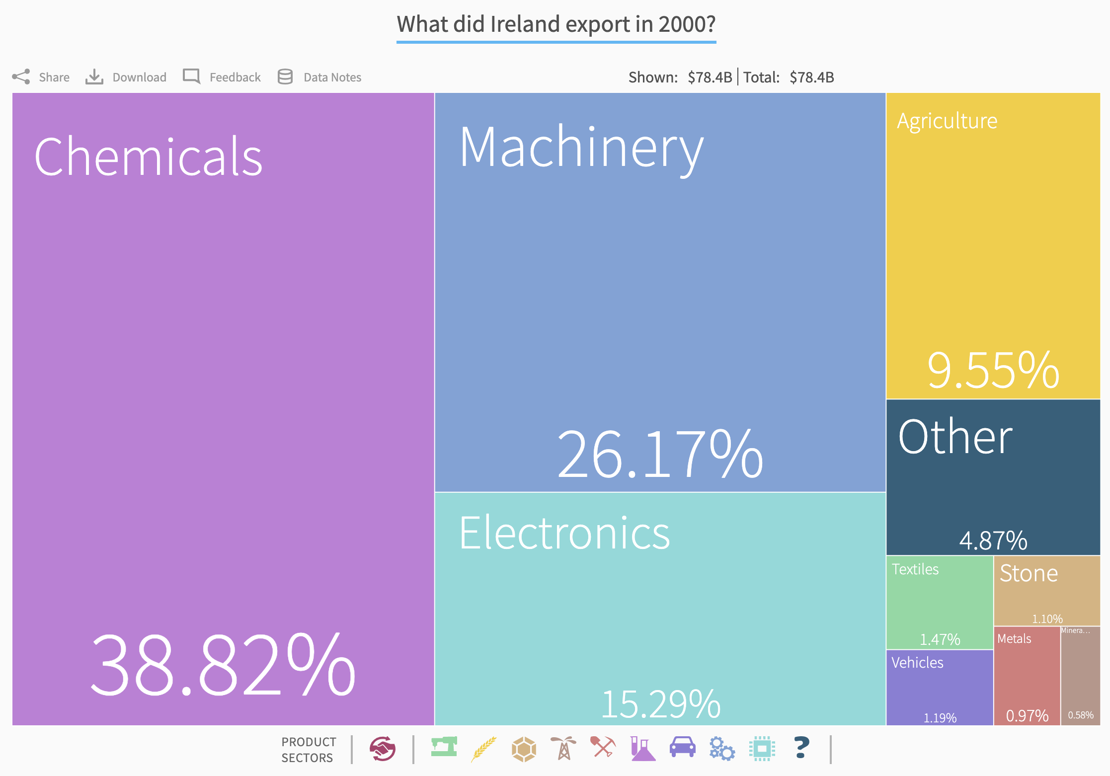
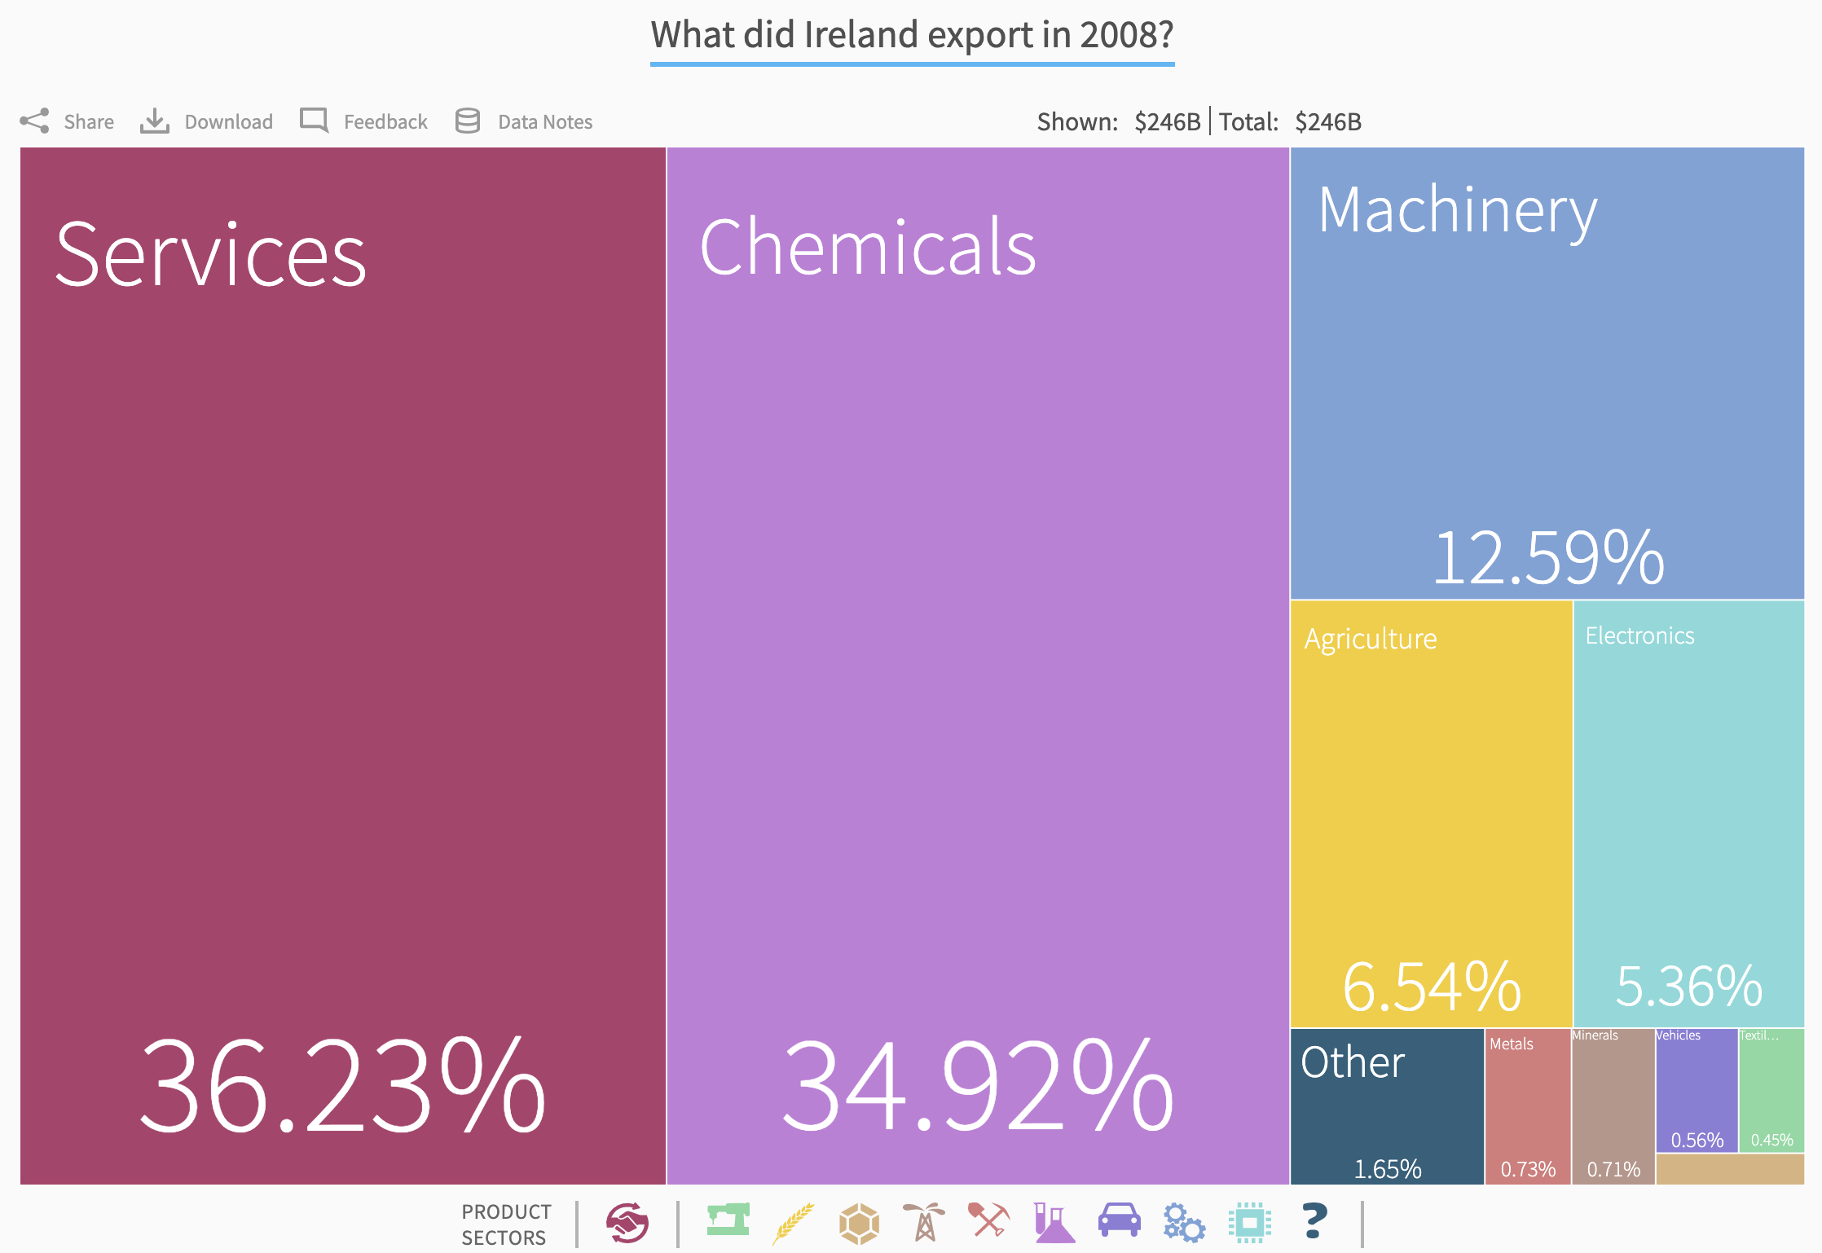
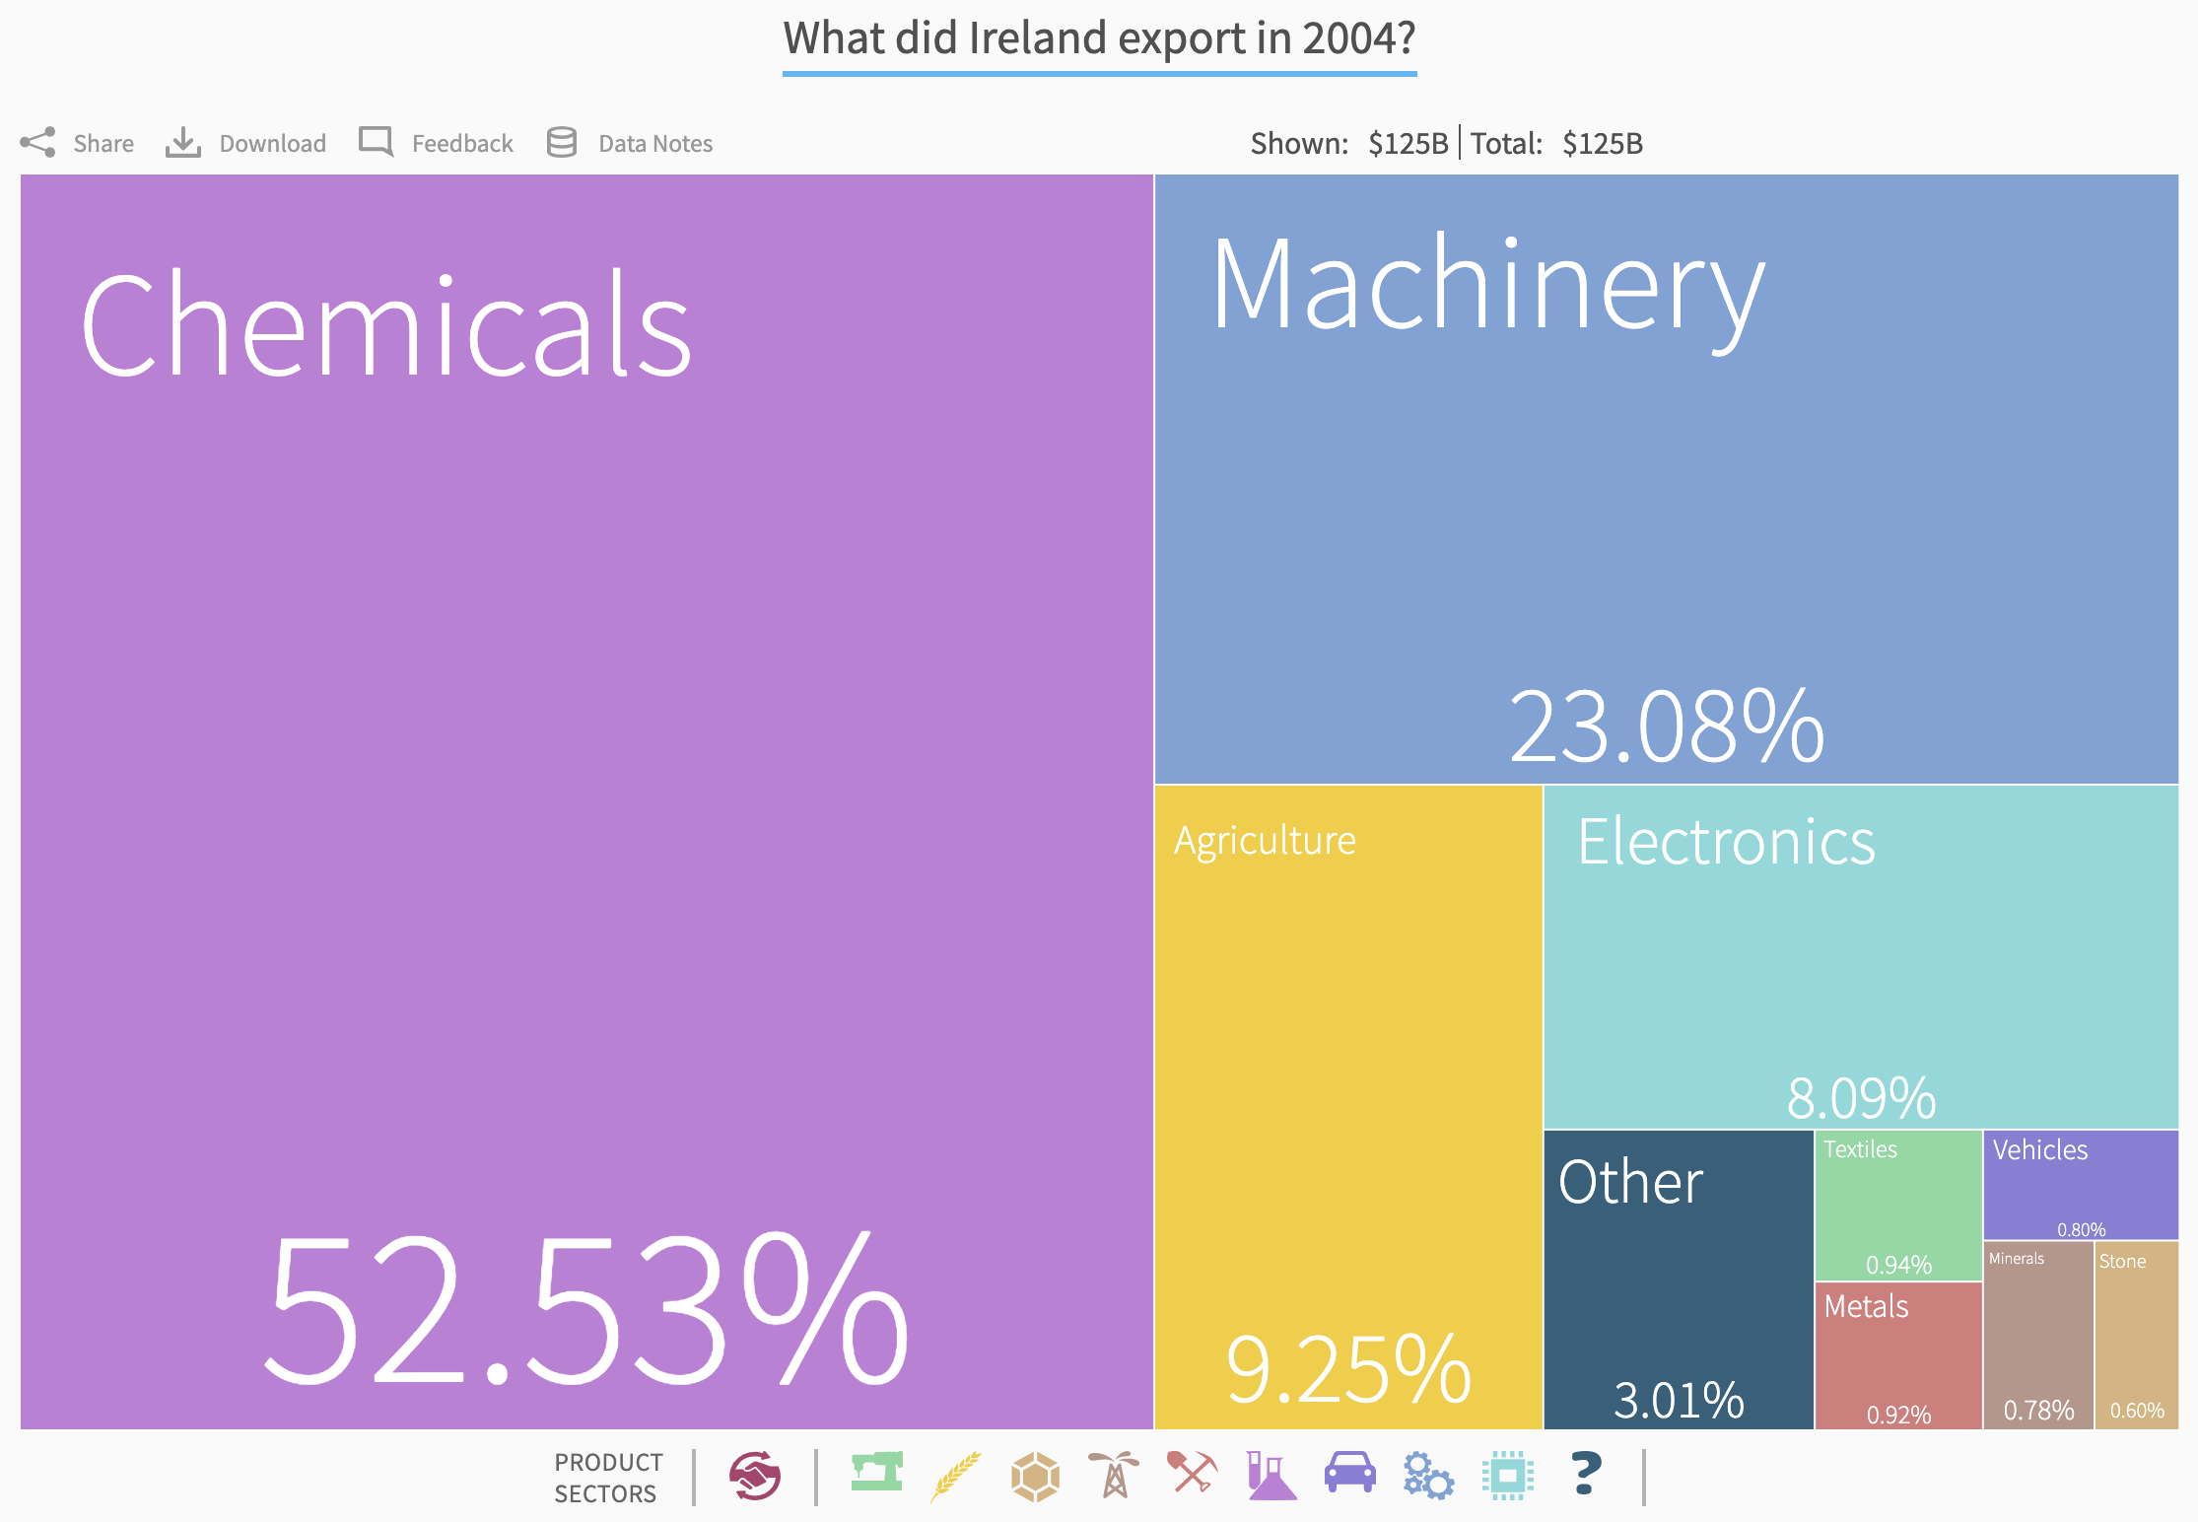
What did Ireland export in 1996?
What did Ireland export in 2012?
What did Ireland export in 2000?
What did Ireland export in 2004?
What did Ireland export in 2008?
http://atlas.cid.harvard.edu/

Slide 3
Recommend exports
across time
Help investors identify potential in untapped product and service areas.
Help countries identify growth opportunity.
Notes:
Lesson 1: Recommendations are not the same as predictions! What we’re really doing here is recommending what countries “should” get into, which in economics doesn’t necessarily map onto what “will” happen.
We’re trying to leverage the idea that countries “will do” what they supposedly “should do” in terms of making easy economic jumps.
Ireland economy changing over time GIF source: https://giphy.com/gifs/ireland-exports-international-trade-ggRQCeeNpns68ymjtA
Direct link: https://media.giphy.com/media/ggRQCeeNpns68ymjtA/giphy.gif
https://www.imf.org/external/pubs/ft/fandd/2012/09/dervis.htm
[How do know how we get from one sparse product network to another more developed network over time? We can compare to countries in the same time period with similar product networks. Find products with lower distance and higher complexity/opportunity gain than your current averages. - can add series of network images to illustrate the “click.”]
Recommendation is based on what they already export, i.e. their strengths in what they already export and their similarity with what other countries
export.
Countries compete for market share in the export product space globally. Making recommendations or predictions about which product area (e.g. agriculture, minerals, technology, etc.) is an important question for both investors and policymakers.
If you’re able to create a graph alignment metric, you can create a metric for comparing country trade networks at an aggregated level - this would better inform how relevant cross-country investing/policy learning and recommendations are.

Slide 4
Why Is It Hard to Make Recommendations Over Time?
Recommenders: User-item recommendations
Across multiple categories
BUT time-static
Time-Series Forecasting: Predictions
Time-dynamic
BUT only single category
Notes:
Two technologies to combine - recommender systems and time series forecasting
Other recommender systems take 1 of 2 approaches:
Time-static, across multiple categories
Time-dynamic, across one category
User-Defined Model Tuning: Can you create an app or a package for helping users easily make recommendations, tuning for variables, such as:
WB Development Indicator weights (e.g. higher weight on countries with similar income inequality)
Overall network similarity (e.g. a graph alignment score)
Products/industries they want to focus on (e.g. this would instead tell us, all else held constant, if I want to grow X product space to a certain level, what country should I compare myself to/am I most like?
Distance to a product space, complexity level of products, etc?

Slide 5



Collaborative Filtering Over a Single Period of Time
1995
Ireland
United Kingdom
https://www.flaticon.com/
Notes:
Tariffs - The Atlas data would not explicitly account for tariffs, however, it may help us predict what potential trade loss may be because of tariffs. The data does implicitly account for tariffs in that it measures real import and export trade volumes.

Slide 6

Collaborative Filtering Over Multiple Time Periods
1995
2005
Ireland
Ireland
United Kingdom
United Kingdom
https://www.flaticon.com/
Notes:
Tariffs - The Atlas data would not explicitly account for tariffs, however, it may help us predict what potential trade loss may be because of tariffs. The data does implicitly account for tariffs in that it measures real import and export trade volumes.

Slide 7
ATLAS DATA: Reducing Search Costs for Complexity Gain
250 COUNTRIES / TERRITORIES
5,000+ PRODUCTS
20 YEARS
25 MILLION RECORDS
Notes:
Product nodes sized by world trade levels
http://atlas.cid.harvard.edu/explore/feasibility/?country=49&partner=undefined&product=undefined&productClass=HS&startYear=undefined&target=Product&year=2017

Slide 8
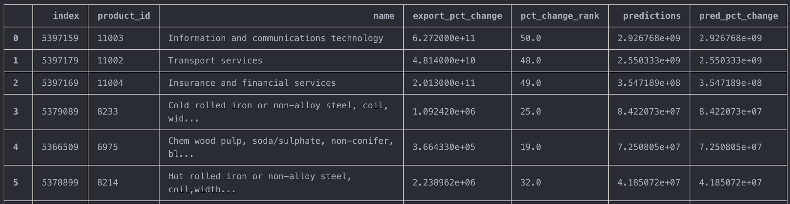
Results: Top Growth Export Areas, by % Change
Recommendations for Ireland for 2005-2014
Notes:
Tariffs - The Atlas data would not explicitly account for tariffs, however, it may help us predict what potential trade loss may be because of tariffs. The data does implicitly account for tariffs in that it measures real import and export trade volumes.

Slide 9
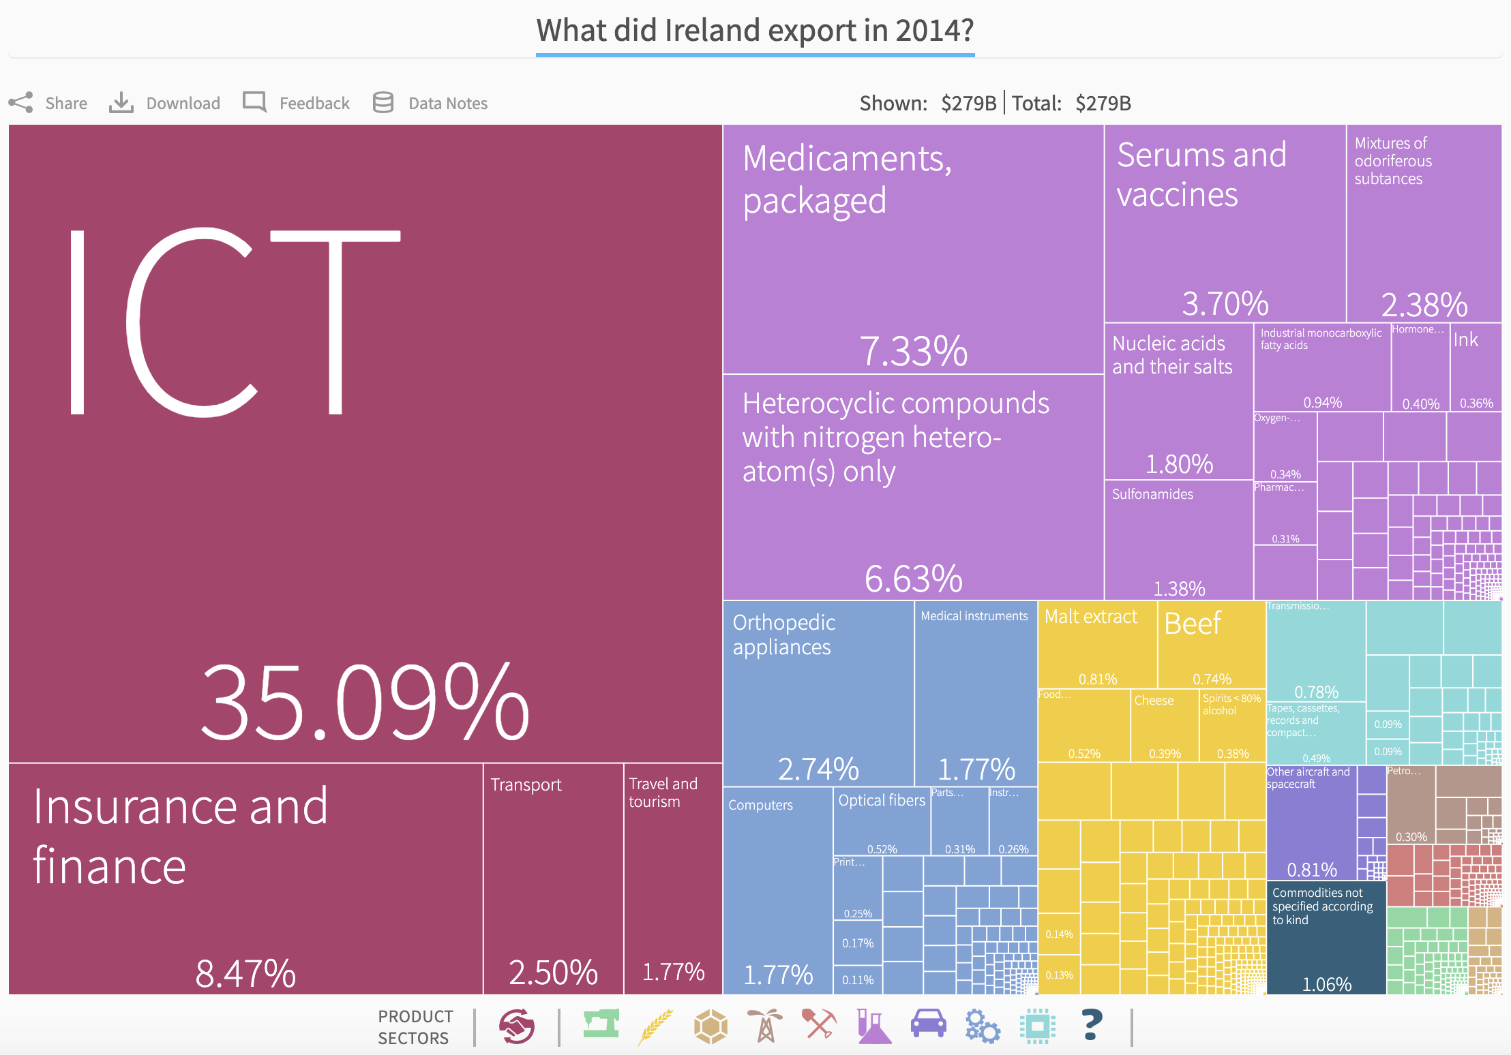
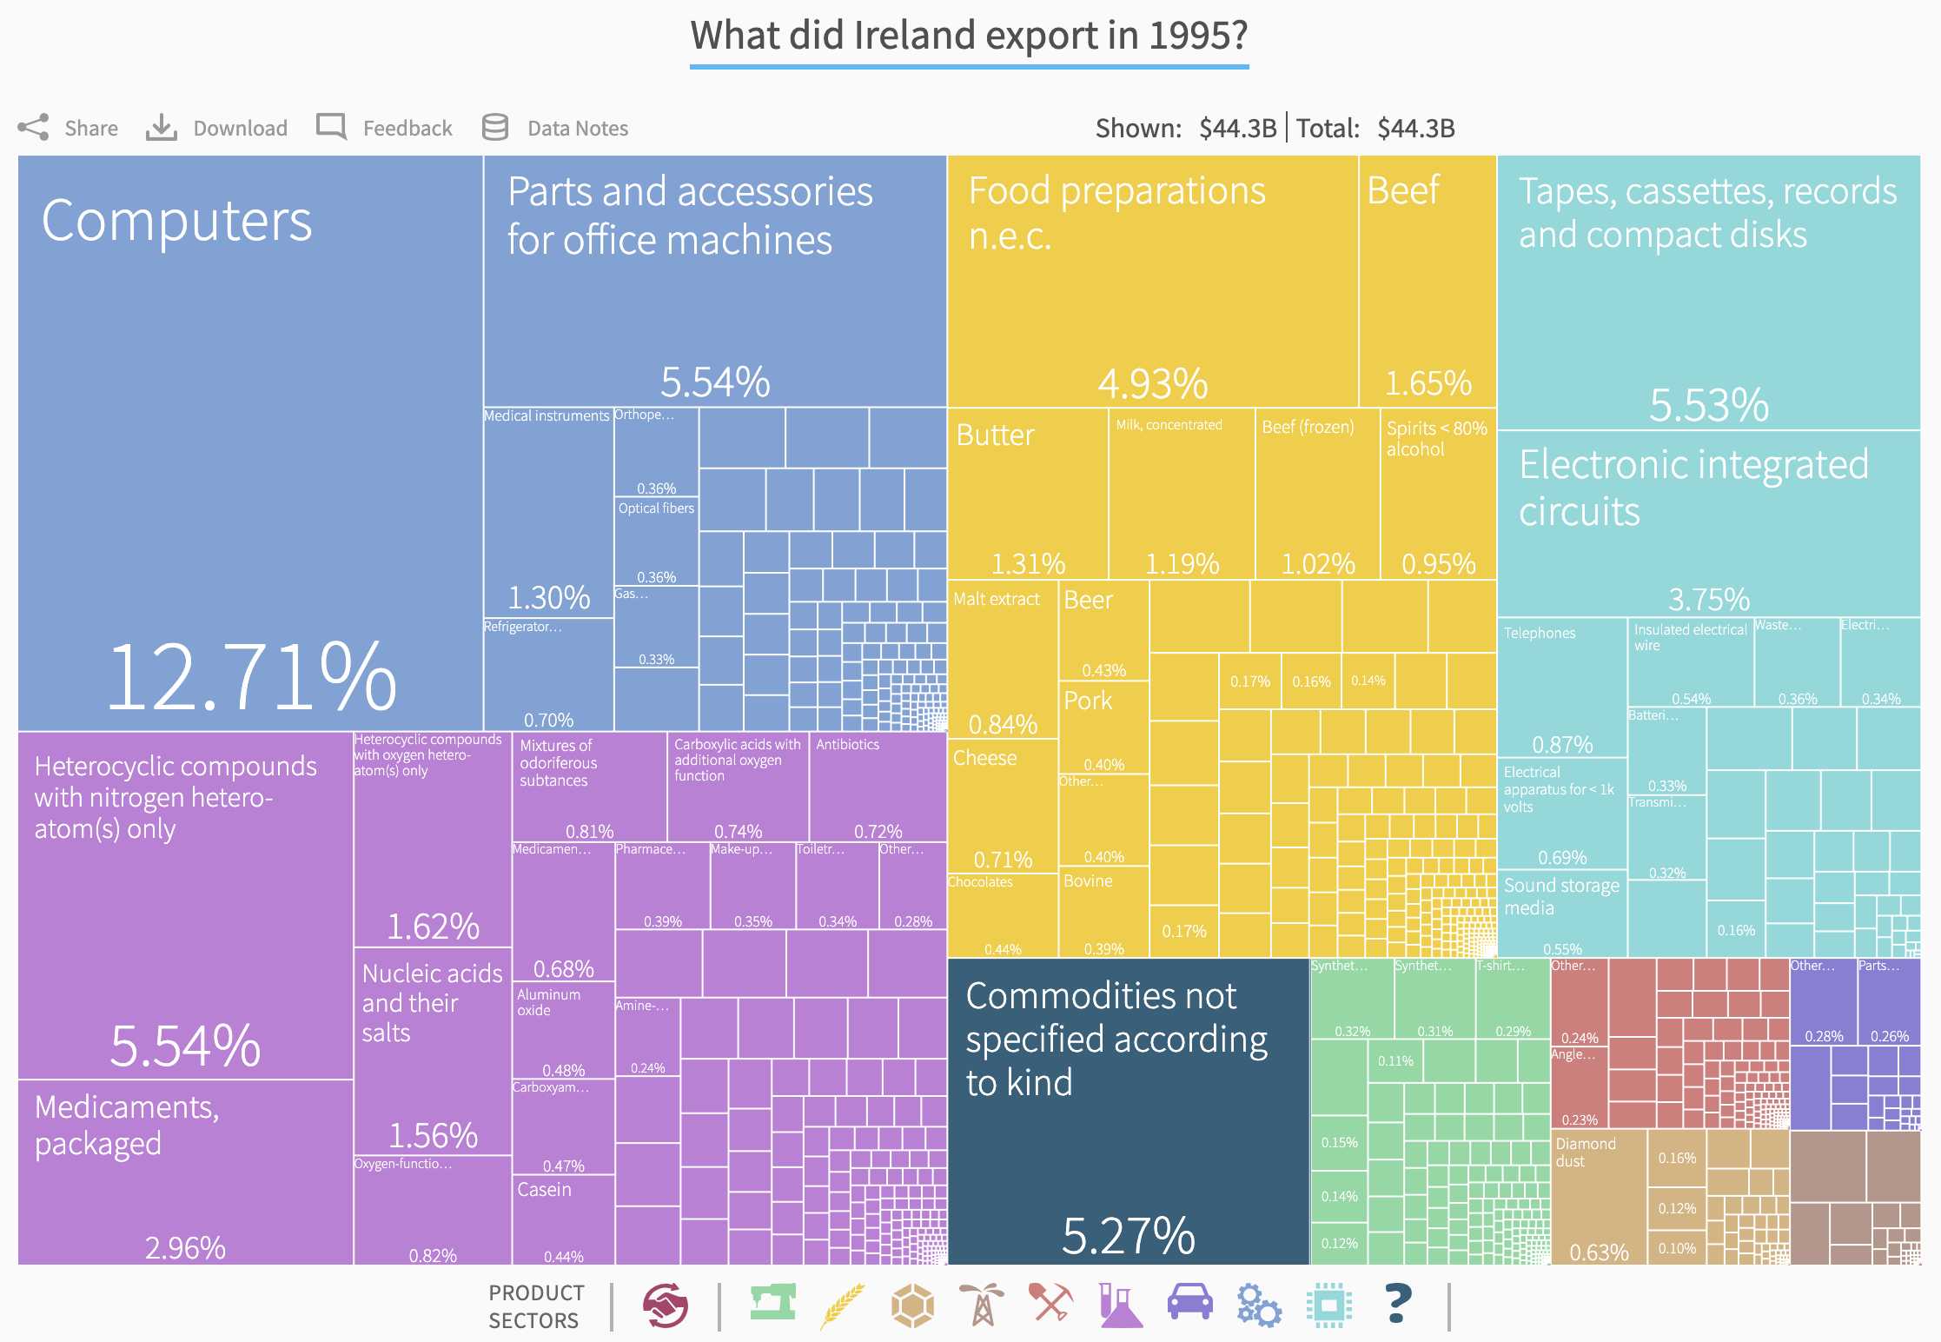
What Did Ireland Export in 1995?
What Did Ireland Export in 2015?
http://atlas.cid.harvard.edu/

Slide 10
Training Pipeline
Analysis
Model Output
Recommended Export Value:
Country
Product
Year
Model
ATLAS Data
Feature Engineer Time Trends
Notes:
Tariffs - The Atlas data would not explicitly account for tariffs, however, it may help us predict what potential trade loss may be because of tariffs. The data does implicitly account for tariffs in that it measures real import and export trade volumes.

Slide 11
Inference Pipeline
Model
Input (Country)
Prediction
(Export Value)
Rank % Change Prediction
Make Recs
Notes:
Tariffs - The Atlas data would not explicitly account for tariffs, however, it may help us predict what potential trade loss may be because of tariffs. The data does implicitly account for tariffs in that it measures real import and export trade volumes.

Slide 12
Approaches - Tested
Ease
Accuracy
Time Dimension
1
Normalization of Target Variable
(Value of Exports)
2
Shallow Model
(Dot Product)
3
Fully-Connected Deep Learning Model
4
DL + Time-Series Model
(Using Trend Inputs)
Notes:
Sensitivity - ability to identify true positives out of relevant elements (people with disease) = true positives/(true positives+false negatives)
Specificity - ability to identify true negatives out of relevant elements (people without disease) = true negatives/(true negatives+false positives)
Precision - how many selected items are relevant = true positives/(true positives+false positives)
Recall - how many relevant items are selected = true positives/(true positives+false negatives)
1 - Double-edged sword bc pins us to logic “similar countries follow similar trade trajectories” pins us to logic “countries with similar trade profiles will follow similar trade trajectories” pins us to logic “countries with similar trade profiles will follow similar trade trajectories”
https://en.wikipedia.org/wiki/Sensitivity_and_specificity
https://en.wikipedia.org/wiki/Precision_and_recall

Slide 13
Validation: Comparing Ranks
Model | Cosine Similarity Export Values vs Predictions | Rank Cosine Similarity Export % Change Rank vs Predictions
KNN | 0.024 | 0.825
1-Layer Dot Product Neural Net | 0.624 | 0.664
3-Layer Neural Net | 0.543 | 0.673
3-Layer Neural Net + Time Features | 0.531 | 0.661
5-Layer Neural Net | 0.514 | 0.854
5-Layer Neural Net + Time Features | 0.524 | 0.854
Model | Cosine Similarity Export Values vs Predictions | Rank Cosine Similarity Export % Change Rank vs Predictions
KNN | 0.024 | 0.825
1-Layer Dot Product Neural Net | 0.624 | 0.664
3-Layer Neural Net | 0.543 | 0.673
3-Layer Neural Net + Time Features | 0.531 | 0.661
5-Layer Neural Net | 0.514 | 0.854
5-Layer Neural Net + Time Features | 0.524 | 0.854
Notes:
The introduction of engineered features made it such that I needed to make the NN a DL feed-forward neural net, otherwise it did not train well
KNN was trained on export_val_norm_all rather than export_val_std_all in order to restrict prediction range [0,1] for surprise pacakage - it ends up predicting everything as 1
Tariffs - The Atlas data would not explicitly account for tariffs, however, it may help us predict what potential trade loss may be because of tariffs. The data does implicitly account for tariffs in that it measures real import and export trade volumes.

Slide 14










Faran Sikandar
Harvard University
MPA/ID Quantitative Economics
University of California at Berkeley
BS Business Administration + BA Philosophy

Slide 15
APPENDIX

Slide 16
Approaches - To Do
Ease
Accuracy
Time Dimension
Notes
1
LSTM / GRU Architectures
?
?
Prediction across SINGLE categories
Collaborative filtering DILUTED?
2
Oversampling / Undersampling
(Minority Class)
EASY to filter to dense dataset, but LIMITS generalizability
3
Increasing Frequency of Time Features
May lead to overfitting
4
Graph Alignment
(DL Training + Feature Engineering)
?
STRONGER country comparisons
Human INTERPRETABLE
May be redundant
Notes:
Sensitivity - ability to identify true positives out of relevant elements (people with disease) = true positives/(true positives+false negatives)
Specificity - ability to identify true negatives out of relevant elements (people without disease) = true negatives/(true negatives+false positives)
Precision - how many selected items are relevant = true positives/(true positives+false positives)
Recall - how many relevant items are selected = true positives/(true positives+false negatives)
Loss metrics - (model can either do very well for small OR large export values)
https://en.wikipedia.org/wiki/Sensitivity_and_specificity
https://en.wikipedia.org/wiki/Precision_and_recall

Slide 17
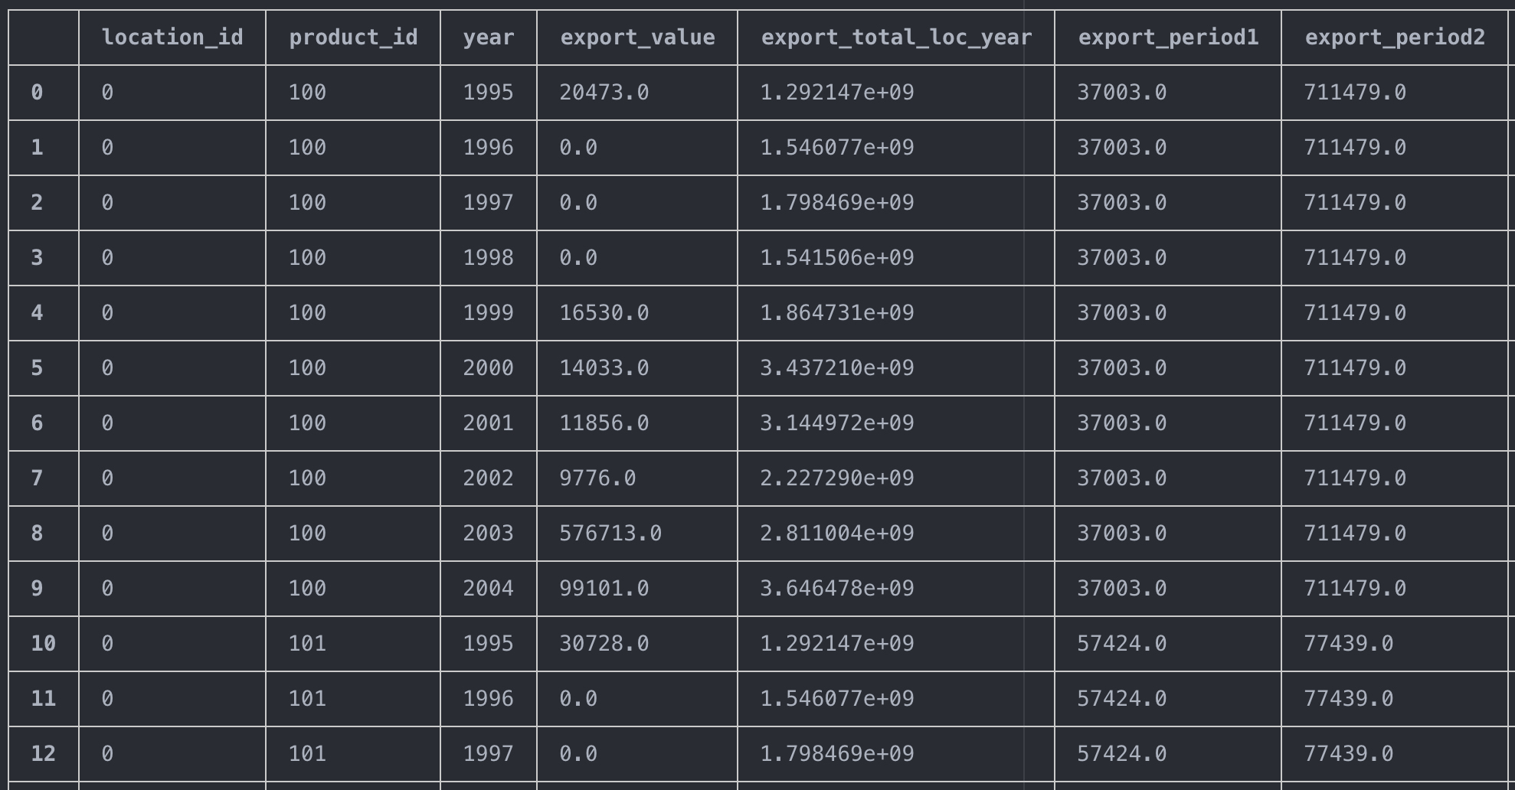
Raw Data Structure
Notes:
Tariffs - The Atlas data would not explicitly account for tariffs, however, it may help us predict what potential trade loss may be because of tariffs. The data does implicitly account for tariffs in that it measures real import and export trade volumes.

Slide 18
Time Series: Feature Engineering
10 Years Training Data: Export Value per Product Area
Second 5 Years: Sum Exports per Product Area
First 5 Years: Sum Exports per Product Area
Overall Trend: Straight Line Growth (Like a Simple Derivative)

Slide 19
Neural Net Model Architecture
Country + Product IDs
Numerical Features
(Time Trends)
Embedding Layer
Dense + Dropout Layers
Concatenate
Dense/LSTM + Dropout Layers
Output

Slide 20
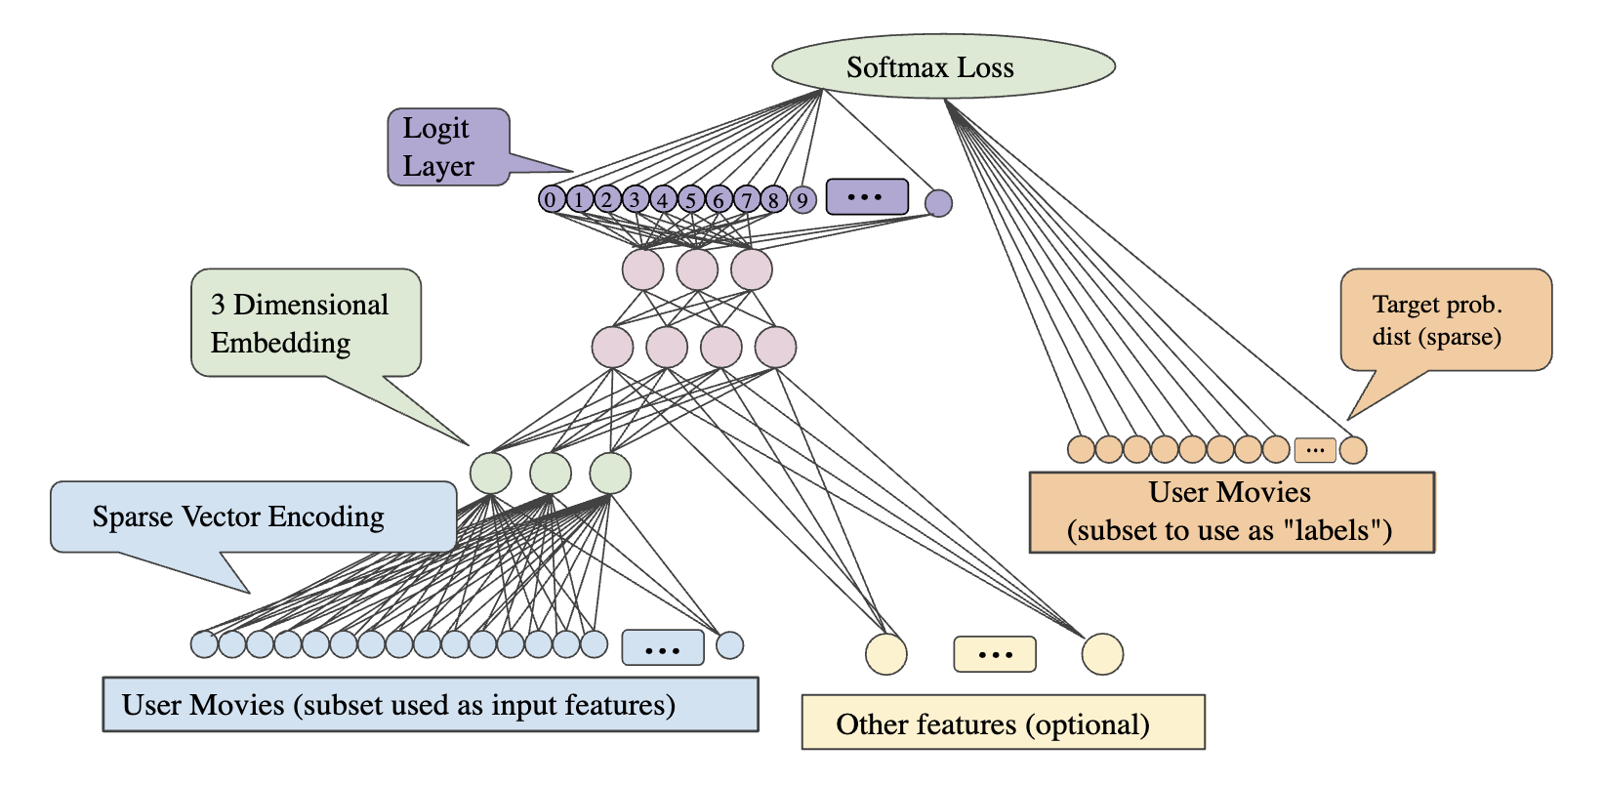
How Embeddings Work - User-Movie Collaborative Filtering
Notes:
Blue User Movies = sparse vector of all user movies watched (e.g. 1 million users)...in this case, training data will be subset of say 70% of movies a user watched
Orange User Movies = sparse vector of user movies watched (remaining 30% of movies a user watched)
Green 3-Dimensional Embedding = n_latent_factors to embed - each of these nodes represent a geometric view of the embedding - the links from each user to the embedding node represent weights
Pink Nodes = hidden layers
Purple Logit Layer = list of possible classifications, e.g. if 500,000 movies, then will be 500,000 nodes - more nodes is a bad thing (because can mean overfitting? Hard to train?)
Yellow Other Features = other features (e.g. genre, year, director, etc. - can also be embeddings or can be numerical features)
Green Softmax Loss -> Minimize Purple Classification relative to Orange User Movies Test Data
Rule of thumb: # dimensions ~= (# possible values)^(¼)
https://developers.google.com/machine-learning/crash-course/embeddings/obtaining-embeddings

Slide 21
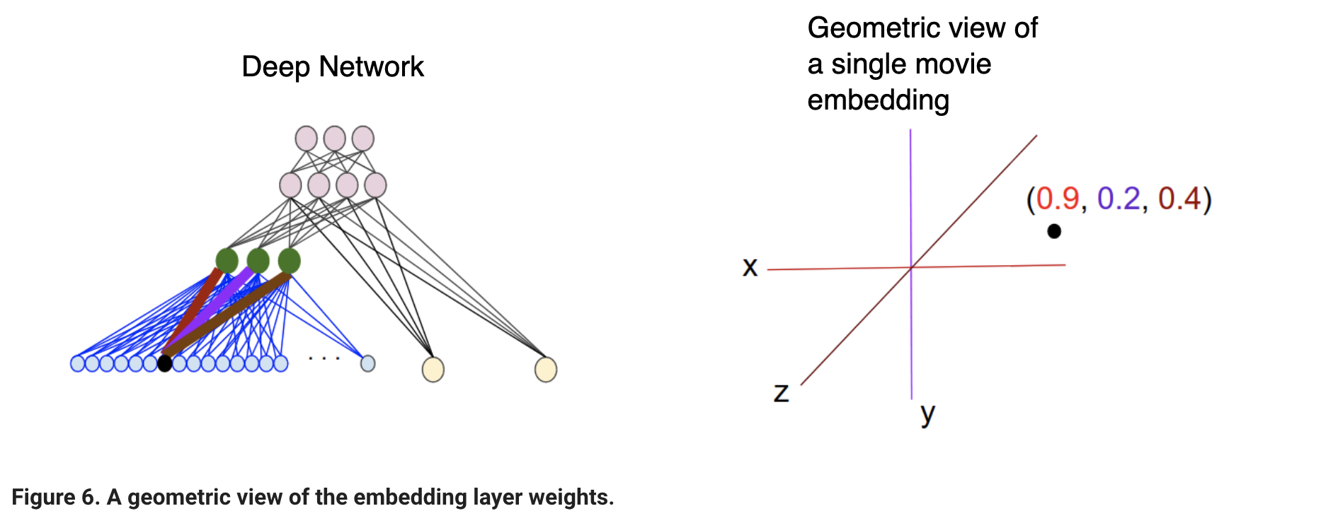
How Embeddings Work - User-Movie Collaborative Filtering
Notes:
As another example if you want to create an embedding layer for the words in a real-estate ad as part of a DNN to predict housing prices then you'd optimize an L₂ Loss using the known sale price of homes in your training data as the label.
When learning a d-dimensional embedding each item is mapped to a point in a d-dimensional space so that the similar items are nearby in this space. Figure 6 helps to illustrate the relationship between the weights learned in the embedding layer and the geometric view. The edge weights between an input node and the nodes in the d-dimensional embedding layer correspond to the coordinate values for each of the d axes.

Slide 22
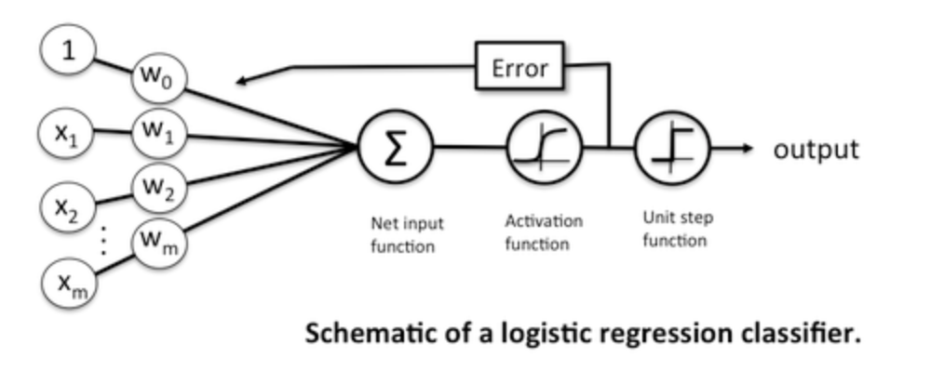
Neural Networks As Stacked Regression Nodes
Notes:
Neural networks are somewhat related to logistic regression. Basically, we can think of logistic regression as a one layer neural network.
In fact, it is very common to use logistic sigmoid functions as activation functions in the hidden layer of a neural network – like the schematic above but without the threshold function.

Slide 23
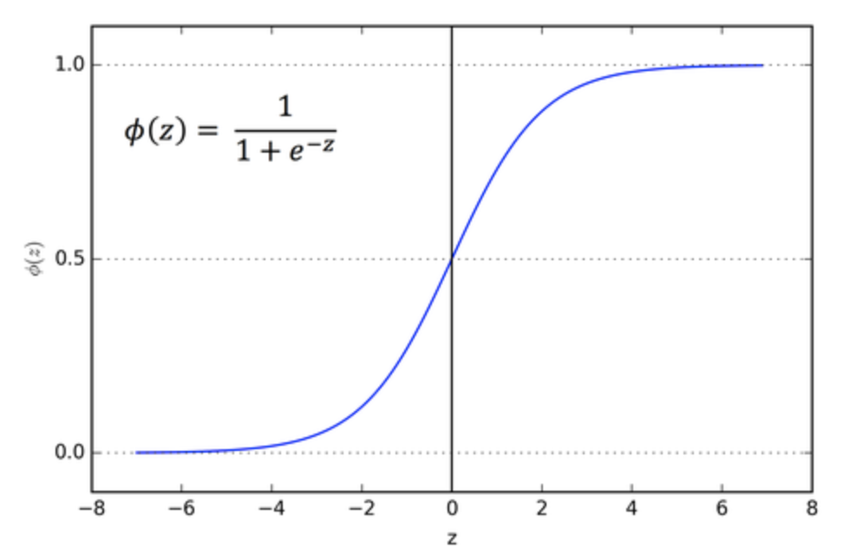
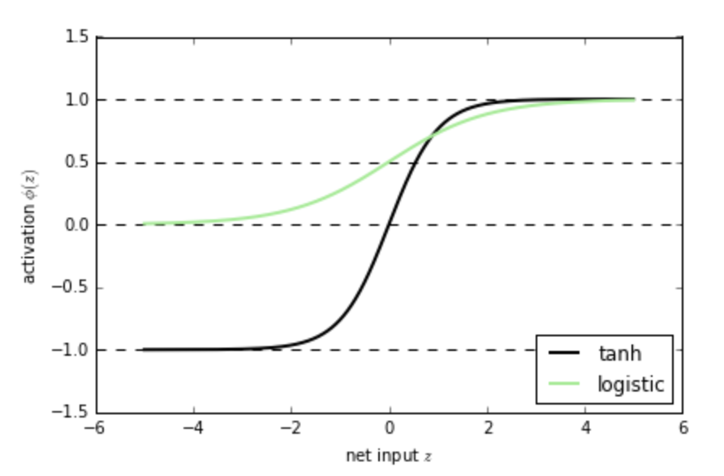
Sigmoid Activation + Tanh Activation
Notes:
Although, I mentioned that neural networks (multi-layer perceptrons to be specific) may use logistic activation functions, the hyperbolic tangent (tanh) often tends to work better in practice, since it’s not limited to only positive outputs in the hidden layer(s).
https://sebastianraschka.com/faq/docs/logisticregr-neuralnet.html

Slide 24
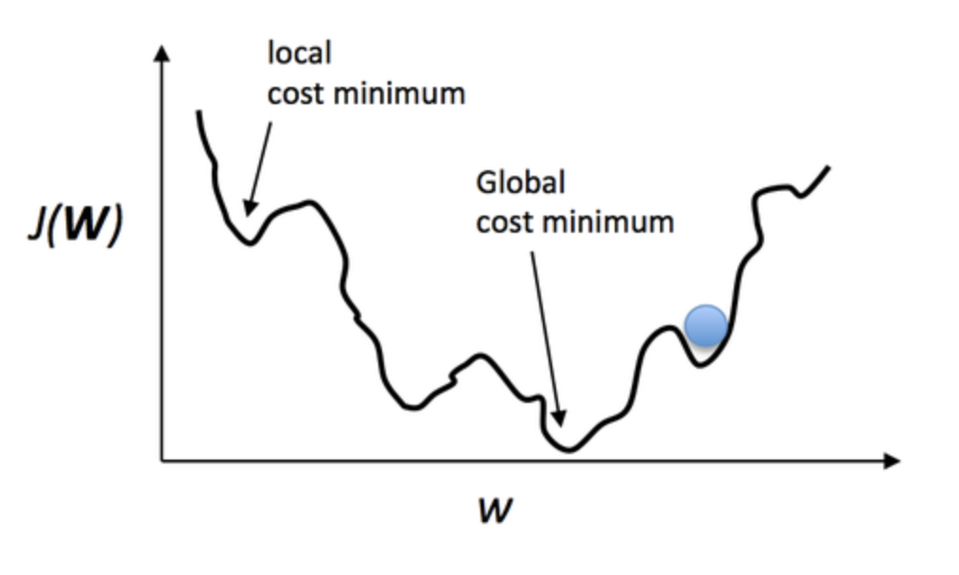
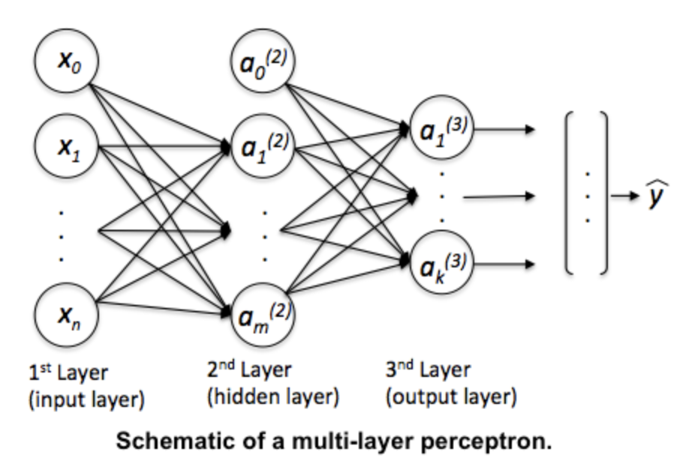
Local Minima + Multi-Layer Perceptron
Notes:
Anyway, going back to the logistic sigmoid. One of the nice properties of logistic regression is that the logistic cost function (or max-entropy) is convex, and thus we are guaranteed to find the global cost minimum. But, once we stack logistic activation functions in a multi-layer neural network, we’ll lose this convexity. Looking only at a single weight / model coefficient, we can picture the cost function in a multi-layer perceptron as a rugged landscape with multiple local minima that can trap the optimization algorithm:
However, in practice, backpropagation works quite well for 1 or 2 layer neural networks (and there are deep learning algos such as autoencoders) to help with deeper architectures. Even if you may likely converge to a local minima, you often still end up with a powerful predictive model. So, in summary, I would recommend to approach a classification problem with simple models first (e.g., logistic regression). In some cases, this may already solve your problem sufficiently well. However, if you are not satisfied with it’s performance and you have sufficient training data, I’d try to train a computationally more expensive neural network, which has the advantage to learn more complex, non-linear functions.
https://sebastianraschka.com/faq/docs/logisticregr-neuralnet.html

Slide 25
Validation: Potential Methods
Cosine Similarity - Comparing predictions with what actually happened
Comparing Actual Ranks with Predicted Ranks - Eyeball estimate
Develop a Country Similarity Score - E.g. Graph alignment or using various World Bank Development Indicators
Forecast Individual Product Areas - Compare forecasts for individual product areas with the predicted export values
Notes:
Two technologies to combine - recommender systems and time series forecasting
Other recommender systems take 1 of 2 approaches:
Time-static, across multiple categories
Time-dynamic, across one category
User-Defined Model Tuning: Can you create an app or a package for helping users easily make recommendations, tuning for variables, such as:
WB Development Indicator weights (e.g. higher weight on countries with similar income inequality)
Overall network similarity (e.g. a graph alignment score)
Products/industries they want to focus on (e.g. this would instead tell us, all else held constant, if I want to grow X product space to a certain level, what country should I compare myself to/am I most like?
Distance to a product space, complexity level of products, etc?

Slide 26
Validation Metrics
Metric | Implemented | Tradeoffs
Mean Squared Error | Yes | Large values, difficult to interpret
Cosine Similarity | Yes | Fixed [-1, 1] range; Sensitive to small perturbations
Rank Cosine Similarity | Yes | Accounts for order, but not recall or coverage
MAP@K (Mean Average Precision @ Cutoff K) | No | Unclear if it technically applies to econ problem; Classification-based
MAR@K (Mean Average Recall @ Cutoff K) | No | Unclear if it technically applies to econ problem; Classification-based
Notes:
You might ask more deeply, is the recommender system the appropriate tool? Ricardo Hausmann and Paul Krugman
Trading partner with the higher trade flows will dominate the relationship - probably; higher trade overall, but net gain will go to the bigger country

Slide 27
Shortcomings to Collaborative Filtering
 | Reference: Bangladesh | Comparison: Pakistan | Will Bangladesh Break In?
Agriculture | Yes | Yes | X
Electronic Circuits | No | No | ?
Garments/Light Manufacturing | Yes | No | ?
Information Technology | No | Yes | ?
Soccer Balls | No | Yes | ?
Notes:
You might ask more deeply, is the recommender system the appropriate tool? Ricardo Hausmann and Paul Krugman
Trading partner with the higher trade flows will dominate the relationship - probably; higher trade overall, but net gain will go to the bigger country

Slide 28
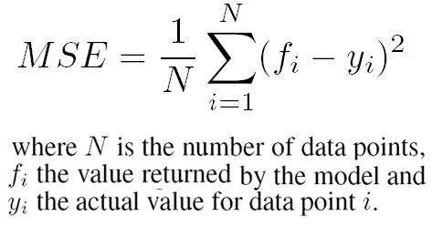
Mean Squared Error
https://www.researchgate.net/figure/Mean-Squared-Error-formula-used-to-evaluate-the-user-model_fig1_221515860

Slide 29
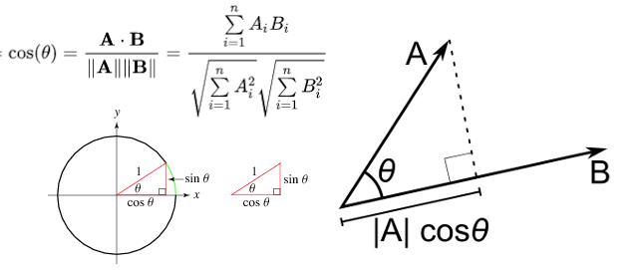
Cosine Similarity - Between Vectors
http://www.ahmetyildirim.com.tr/2018/03/simple-cosine-similarity-for-php.html

Slide 30
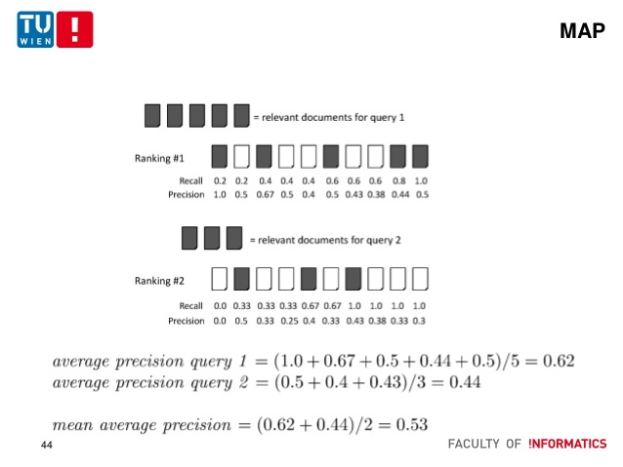
MAP (Mean Average Precision) - How Relevant Recs Are
https://www.slideshare.net/JosRamnRosViqueira/information-retrieval-evaluation-64158263

Slide 31
Data: The Atlas of Economic Complexity
Meta-Data
250 countries
20 categories of goods and 5 categories of services
6,000 products
1 MM + edges between product nodes in a year
Data from 1995-2017
Core Metrics for Recommendation
Proximity between product nodes (edge weights)
Import/export volumes (user ratings)
Metrics for Model Tuning
Complexity metrics (Atlas)
Comparative advantage metrics (Atlas)
Network similarity score (graph alignment)
World Bank Development Indicator data
Notes:
"The Atlas of Economic Complexity," Center for International Development at Harvard University, http://www.atlas.cid.harvard.edu

Slide 32
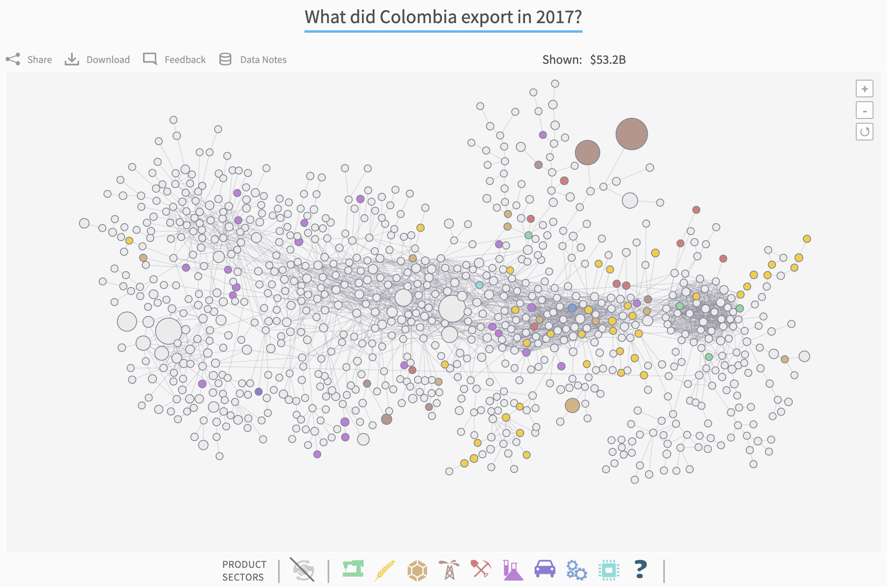

Slide 33
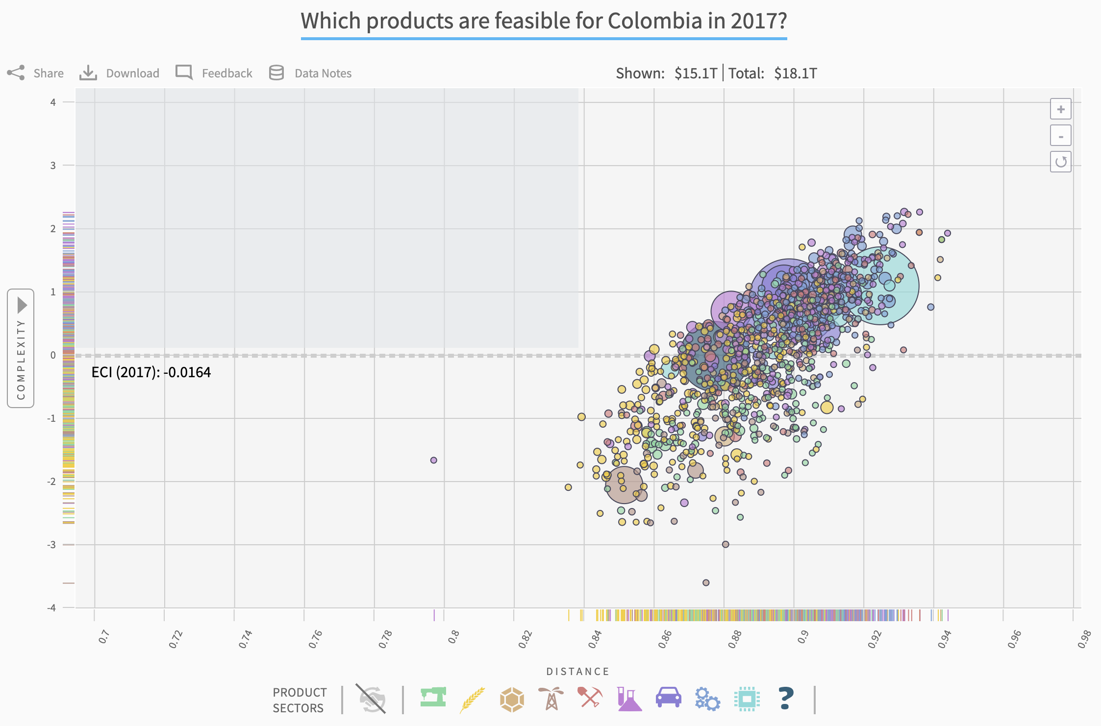

Slide 34
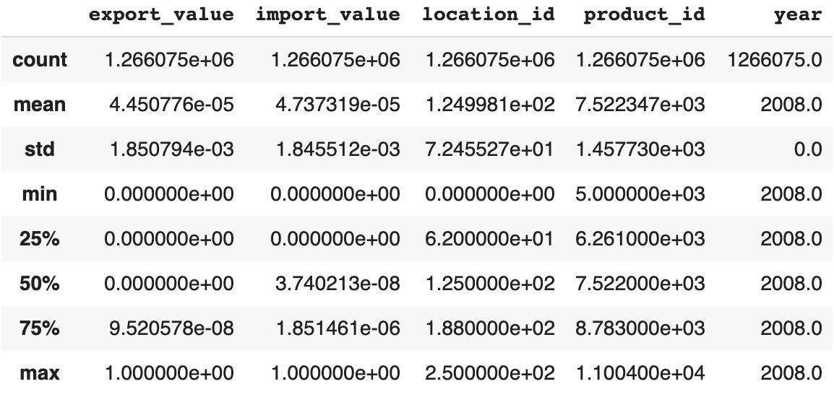
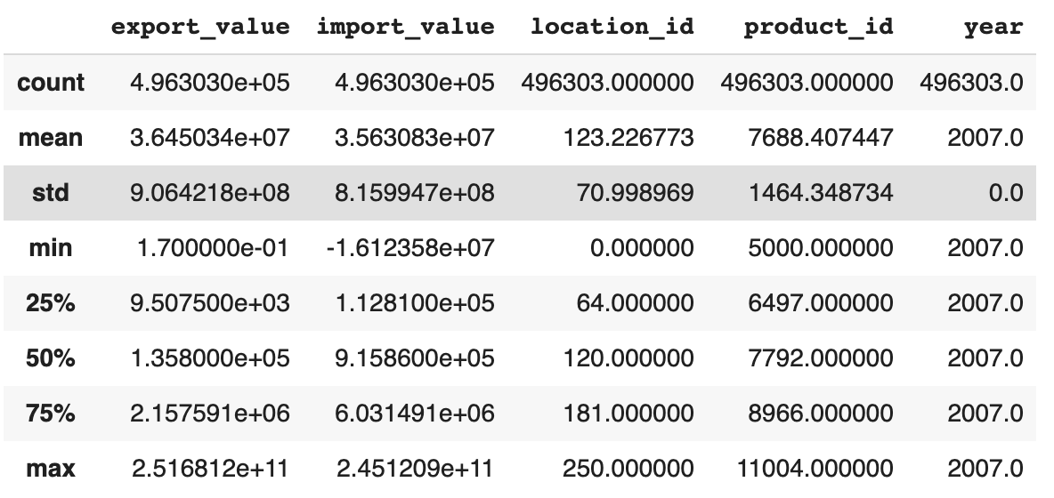
Data Issues - Class Imbalance
Imputing 0s for NaNs
Dropping NaNs

Slide 35
Validation: Comparing Ranks
Model | Cosine Similarity Export Values vs Predictions | Cosine Similarity Export % Change vs Predictions | Rank Cosine Similarity Export Values Rank vs Predictions
KNN | 0.024 | 0.008 | 0.825
1-Layer Dot Product Neural Net | 0.624 | 0.733 | 0.664
3-Layer Dot Neural Net
3-Layer Neural Net | 0.543 | 0.730 | 0.673
3-Layer Neural Net + Time Features | 0.531 | 0.730 | 0.661
3-Layer Dot Neural Net + Time Features | 0.198 | 0.446 | 0.682
5-Layer Neural Net | 0.514 | 0.709 | 0.854
5-Layer Neural Net + Time Feat (Class OR Rank)
5-Layer Neural Net + Time Features | 0.524 | 0.691 | 0.854
5-Layer Neural Net + Time Features v2 | 0.541 | 0.645 | 0.846
Notes:
The introduction of engineered features made it such that I needed to make the NN a DL feed-forward neural net, otherwise it did not train well
KNN was trained on export_val_norm_all rather than export_val_std_all in order to restrict prediction range [0,1] for surprise package - it ends up predicting everything as 1
Tariffs - The Atlas data would not explicitly account for tariffs, however, it may help us predict what potential trade loss may be because of tariffs. The data does implicitly account for tariffs in that it measures real import and export trade volumes.

Slide 36
Validation: Comparing Ranks
Model | Cosine Similarity Export % Change vs Predictions | Rank Cosine Similarity Export % Change Rank vs Predictions
KNN | 0.008 | 0.825
1-Layer Dot Product Neural Net | 0.733 | 0.664
3-Layer Neural Net | 0.730 | 0.673
3-Layer Neural Net + Time Features | 0.730 | 0.661
5-Layer Neural Net | 0.709 | 0.854
5-Layer Neural Net + Time Features | 0.691 | 0.854
Model | Cosine Similarity Export % Change vs Predictions | Rank Cosine Similarity Export % Change Rank vs Predictions
KNN | 0.008 | 0.825
1-Layer Dot Product Neural Net | 0.733 | 0.664
3-Layer Neural Net | 0.730 | 0.673
3-Layer Neural Net + Time Features | 0.730 | 0.661
5-Layer Neural Net | 0.709 | 0.854
5-Layer Neural Net + Time Features | 0.691 | 0.854
Notes:
The introduction of engineered features made it such that I needed to make the NN a DL feed-forward neural net, otherwise it did not train well
KNN was trained on export_val_norm_all rather than export_val_std_all in order to restrict prediction range [0,1] for surprise pacakage - it ends up predicting everything as 1
Tariffs - The Atlas data would not explicitly account for tariffs, however, it may help us predict what potential trade loss may be because of tariffs. The data does implicitly account for tariffs in that it measures real import and export trade volumes.

Slide 37
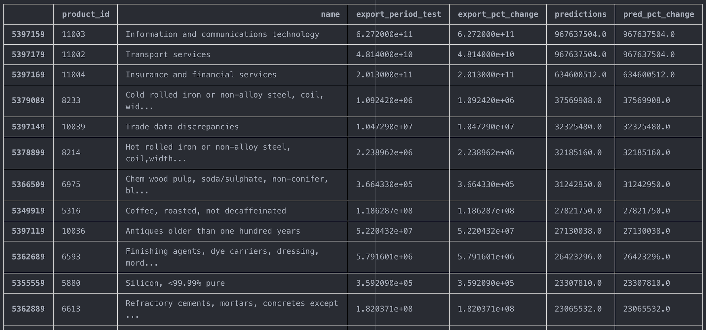
Results: Top N Growth Export Areas, by % Change
Recommendations for Ireland for 2005-2014
Notes:
Tariffs - The Atlas data would not explicitly account for tariffs, however, it may help us predict what potential trade loss may be because of tariffs. The data does implicitly account for tariffs in that it measures real import and export trade volumes.

Slide 38
SUB-APPENDIX

Slide 39

Collaborative Filtering Over Time
1995
2015
Ireland
Ireland
Italy
Italy
United Kingdom
United Kingdom
https://www.flaticon.com/
Notes:
Tariffs - The Atlas data would not explicitly account for tariffs, however, it may help us predict what potential trade loss may be because of tariffs. The data does implicitly account for tariffs in that it measures real import and export trade volumes.

Slide 40
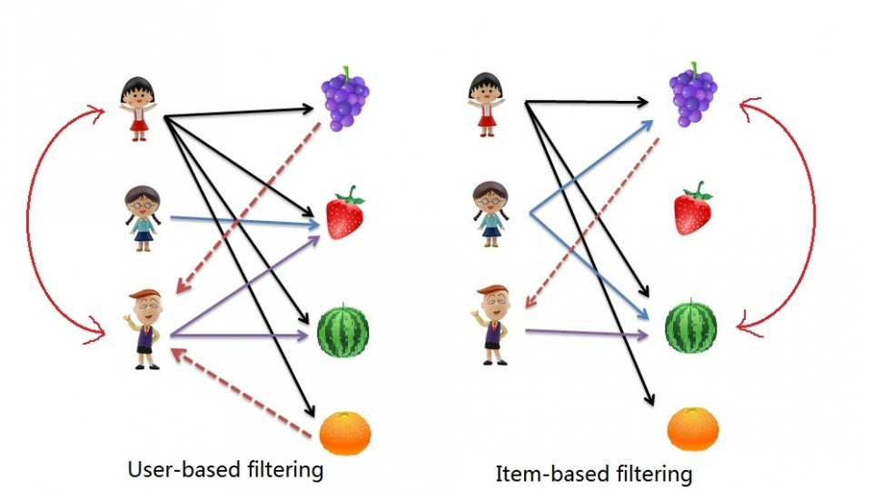
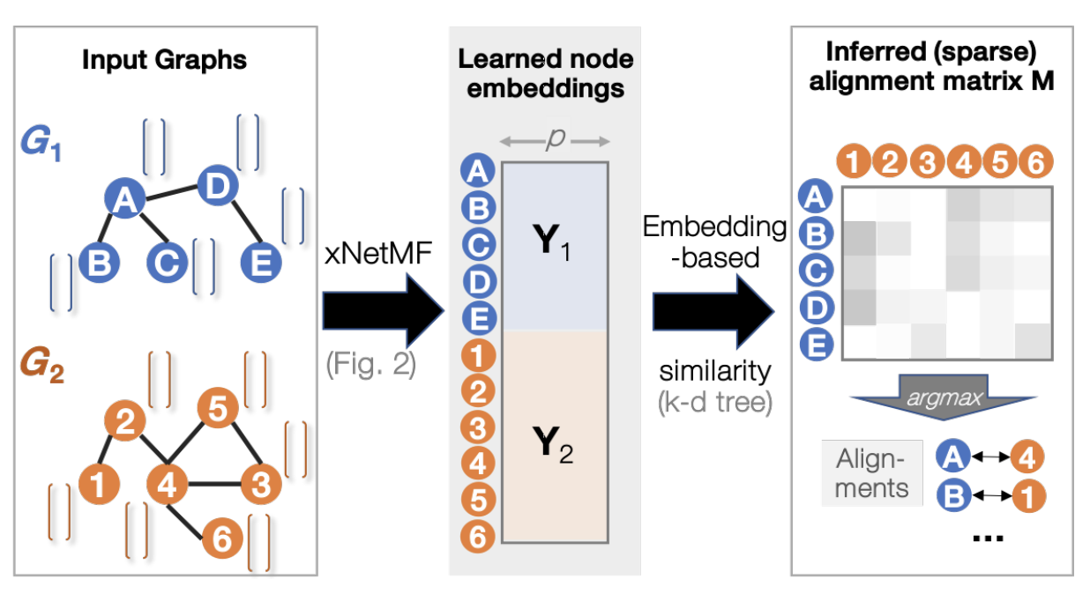
Model: Looking Across Time
Making User-Item Based Recommendations
Collaborative filtering model to create a recommender system
Comparing Networks at a Macro Level
Representation learning based graph alignment (i.e. creating a network similarity score)
Notes:
https://arxiv.org/pdf/1802.06257.pdf
https://cdn-images-1.medium.com/max/1600/1*QvhetbRjCr1vryTch_2HZQ.jpeg

Slide 41
Training Pipeline
Analysis
Model
ATLAS Data
Normalize / Standardize (Many Experiments)
Feature Engineer Time Trends
Model Output:
Predicted Export Value
for Every Country, Product, and Year
Notes:
Tariffs - The Atlas data would not explicitly account for tariffs, however, it may help us predict what potential trade loss may be because of tariffs. The data does implicitly account for tariffs in that it measures real import and export trade volumes.

Slide 42
Challenges
Solutions
Economic Theory - Deciding on targets: Value of exports or percent of exports?
Imbalanced Data / Normalization - Class imbalance + high variance
Time Series - Incorporating an RNN-type structure into the data across multiple categories difficult
Validation - No validation set and want to train the data on the full structure of the economy.
Graph Embeddings - Develop a graph alignment score
Economic Theory - Compare similar export percentages - possibly yields more information between differently sized economies
Imbalanced Data / Normalization - Standardization by country did the trick!
Time Series - Engineer a feature representing the 5-year trend for a country-product class
Validation - Train on one 10-year slice and test on next 10-year slice.
Compare predictions to actual values: subtract from actual values → Ranking.
Graph Embeddings - Create a graph database for each country
Notes:
Tariffs - The Atlas data would not explicitly account for tariffs, however, it may help us predict what potential trade loss may be because of tariffs. The data does implicitly account for tariffs in that it measures real import and export trade volumes.

Slide 43
Challenges and Next Steps
Making a Meaningful Model
Time series analysis to improve model performance across time and predict future trends - start with simply multiplying the target vector (export percent) by the export trend vector
Combine all predictions into one table for fast lookup + ability to compare to actual values
De-normalize predictions to make them easier to interpret
Improve specificity of model by resampling, changing loss measure, or otherwise
Making a Dynamic Model
Figuring out how to use graph databases!
Incorporating improved metrics into the model, e.g. graph alignment similarity score and/or other easily human-interpretable metrics
Creating a tunable model and app interface (with either Atlas or additional metrics)

